Slide 1
ANALYSIS OF FIRE ONBOARD ROPAX FERRY:
Overview to the investigation cases of fire onboard roro passenger ferry in Indonesia
Presented on:
24th Marine Accident Investigators International Forum Meeting
Antalya, Turkey
7-11 June 2015

Slide 2
Ferry Fire Accidents
Philippine - Dona Paz (1987): 4 xxx fatalities
Baltic Sea - Scandinavian Star (1990): 150 fatalities
Philippine - SuperFerry 14 (2004): 60 fatalities
Italy Sea - Vincenzo Floria (2009)
Ionian Sea (off Italy Coast) – Norman Asturias (2014): 8 fatalities
Japan sea – Sunflower Daisetsu (2015): 1 fatality
Indonesia??

Slide 3
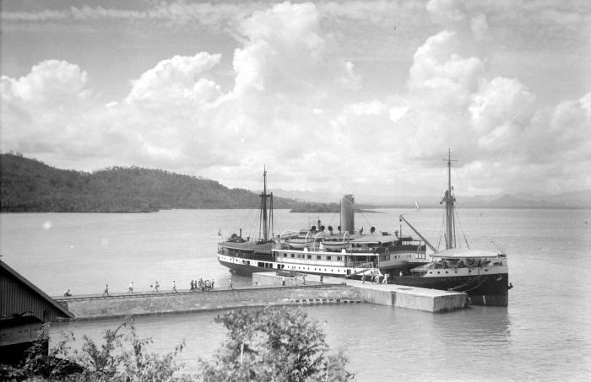
Indonesian Domestic Ropax ferry

Slide 4
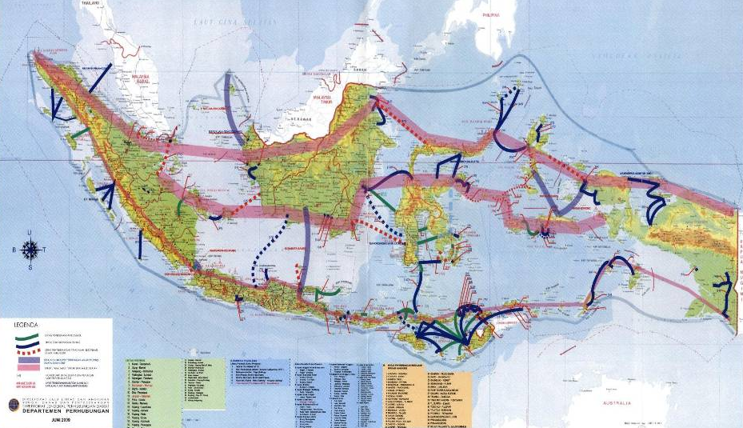
Indonesian Ferry Service
2014 Data:
Fleet:
258 Ferry Ships (15 Pioneer ferry ships)
Lane:
48 Commercial, 169 subsidise
Loading Capacity:
50 Thousand Pax,
6 Thousand Vehicles
Ports:
210 Ferry Ports
2014 Data:
Productivity:
62. 036. 587 Pax
7. 713. 925 Vehicles

Slide 5
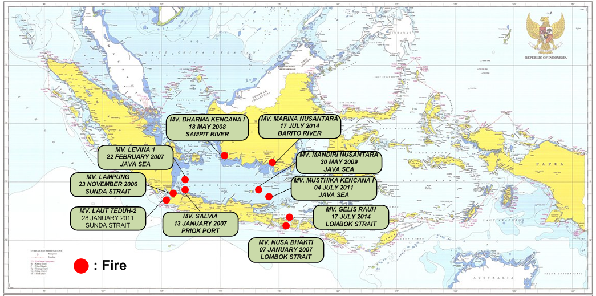
CASES OF FIRE ONBOARD FERRY ROPAX IN INDONESIA (2006 – 2014)

Slide 6
Reviewed Cases
No | Year | Cases | Fire origin (suspected) | Consequence/s
 |  |  |  | To Ship/Cargo | To Passengers
1 | 2006 | MV. Lampung | Main Engine Turbocharge (MS) | Disabled the ship due to heavy damage | Minor Injuries to crew and pax
2 | 2007 | MV. Nusa Bhakti | Non-marine use electric cable (MS) | Medium damage in engine room | No Fatality
3 |  | MV. Levina I | Cargo carried by a vehicle (CD) | Major Damaged to Construction and Acc | 50 fatalities, 18 Minor Injuries
4 | 2008 | MV. Dharma Kencana I | Rolled mooring line (AD) | Heavy Damage to Accommodation area | 1 Fatality
5 | 2009 | MV. Mandiri Nusantara | Cargo carried by a vehicle (CD) | Heavy damaged to the ship | 6 Fatalities
6 | 2011 | MV. Laut Teduh-1 | Vehicle onboard cardeck (CD) | Major Damage to the above water Constr. | 7 Fatalities
7 |  | MV. Salvia | Main Engine (MS) | Minor damaged | No Fatality
8 |  | MV. Musthika Kencana II | Vehicle onboard cardeck (CD) | Total Loss | No Fatality
9 |  | MV. Marina Nusantara | Vehicle onboard cardeck (CD) | Major Damage to the above water constr. | 6 Fatalities
10 | 2014 | MV. Gelis Rauh | Cargo carried by a vehicle (CD) | Disabled the ship due to heavy damage | No Fatality

Slide 7
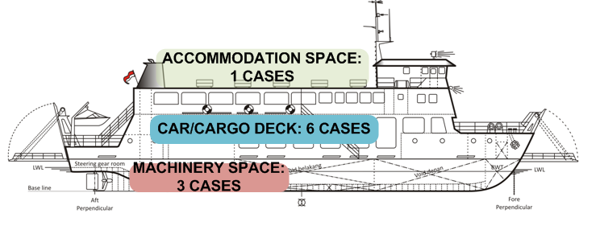
TYPICAL CONSEQUENCES BASED ON EACH TYPE OF FIRE ORIGIN:
Accommodation Space : Medium to Major Damage, Fatality/s
Car deck : Total Loss, Heavy Damaged, Fatalities
Machinery Space : Medium to Heavy Damaged

Slide 8
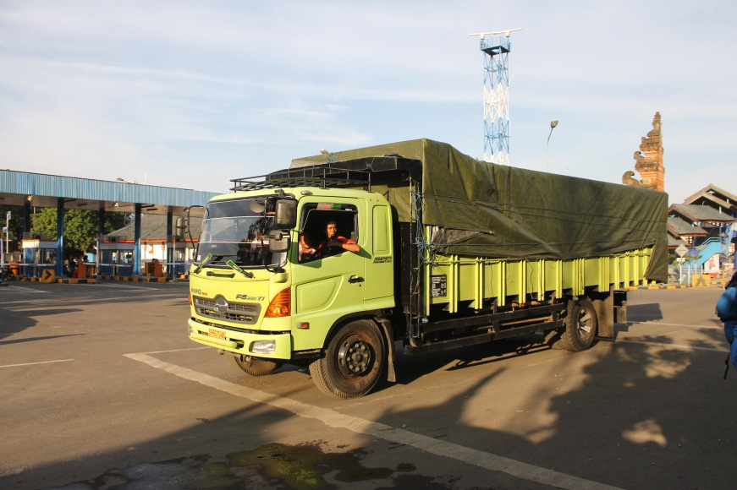
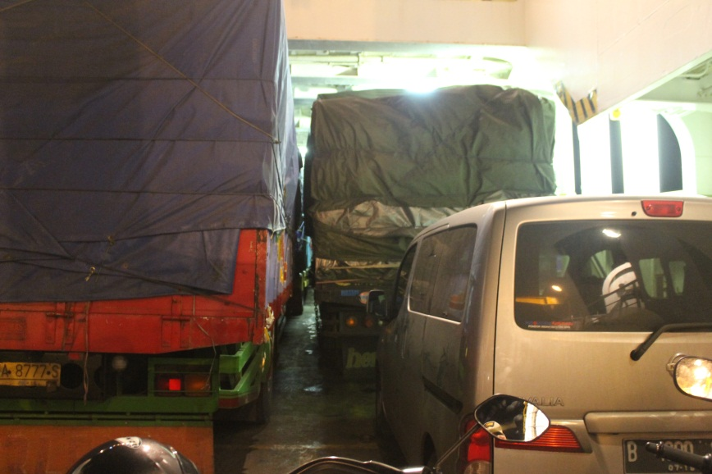
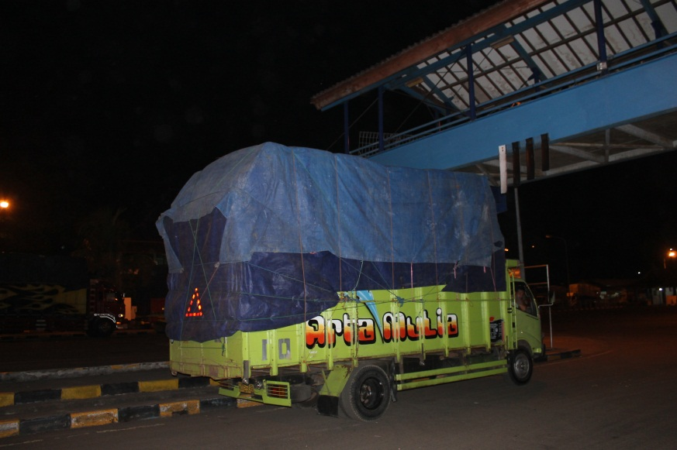
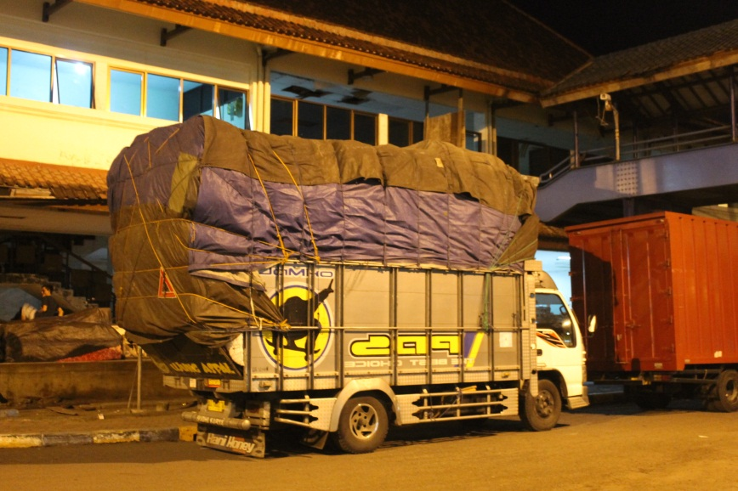
RISK OF FIRE
ON FERRY ROPAX: CARDECK
Condition of Vehicle
Layout and placement
Cargo Handling
Inspection of cargo

Slide 9
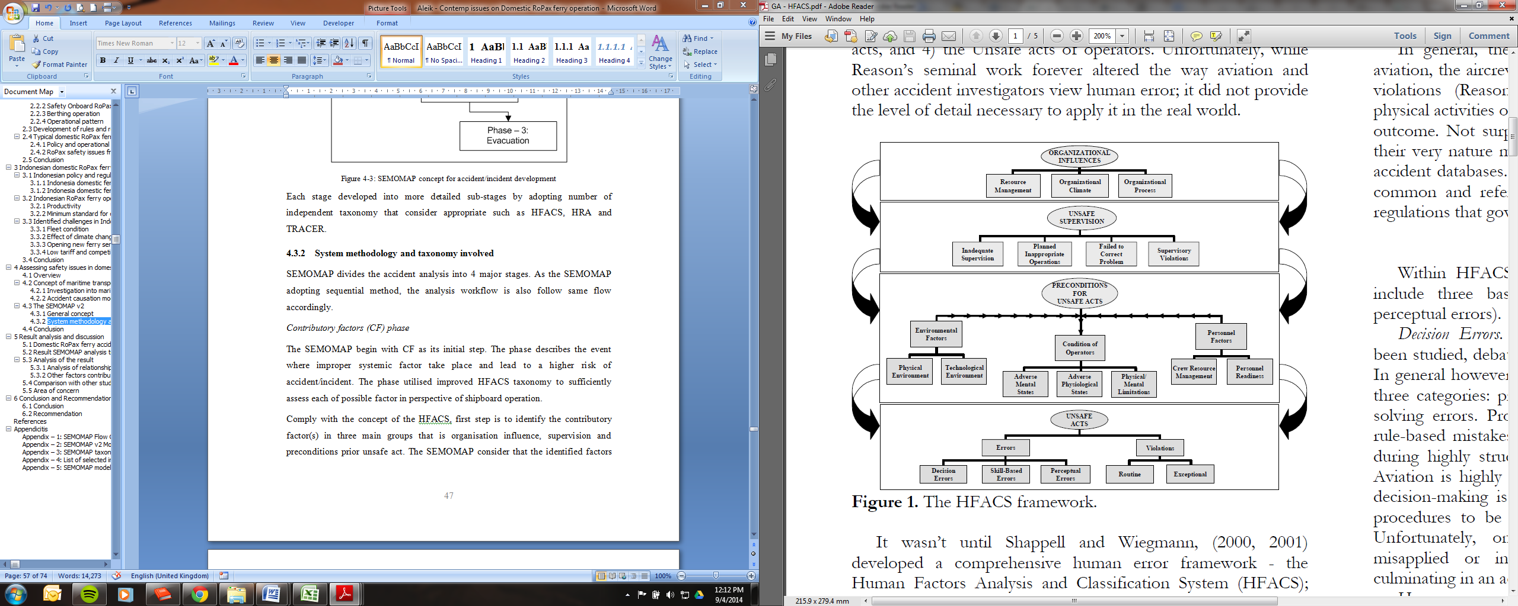
HFACS Model
(by Shappel and Wiegmann - 2000)

Slide 10
CONTRIBUTORY FACTORS

Slide 11
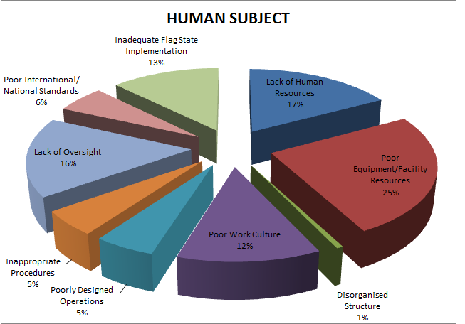
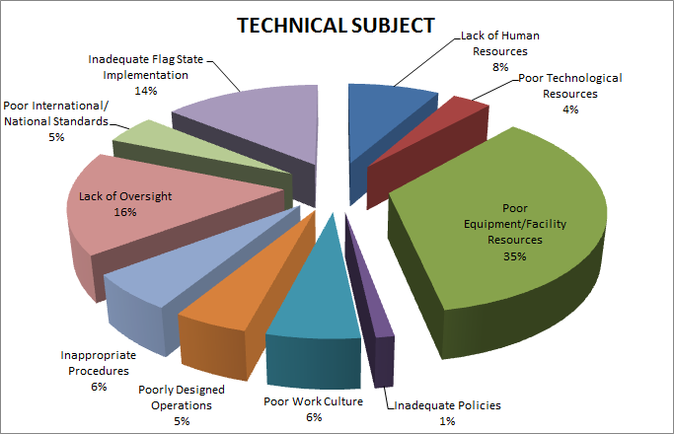
CONTRIBUTORY FACTOR ANALYSIS RESULTS
ORGANISATIONAL INFLUENCE

Slide 12
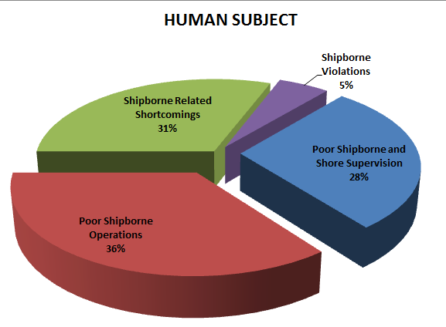
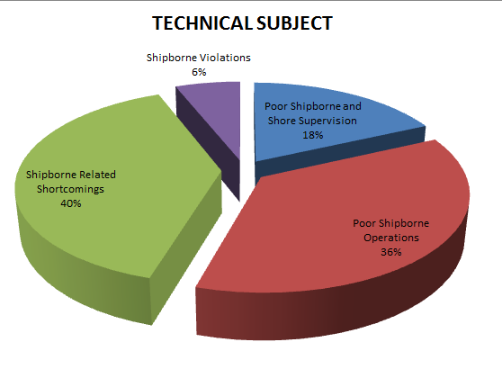
CONTRIBUTORY FACTOR ANALYSIS RESULTS
SUPERVISION

Slide 13
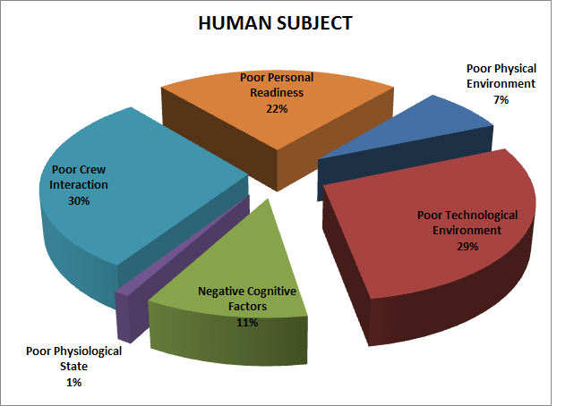
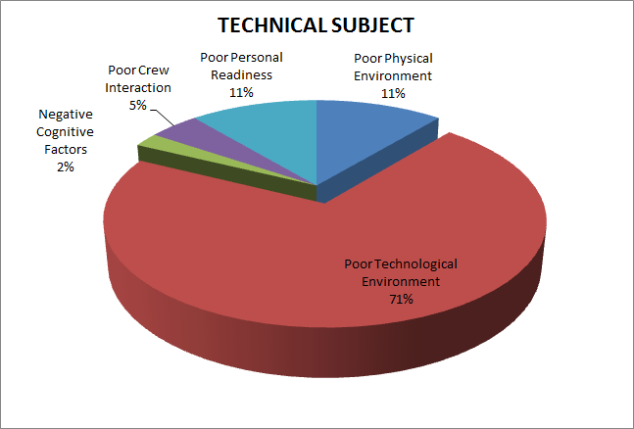
CONTRIBUTORY FACTOR ANALYSIS RESULTS
PRE-CONDITION

Slide 14
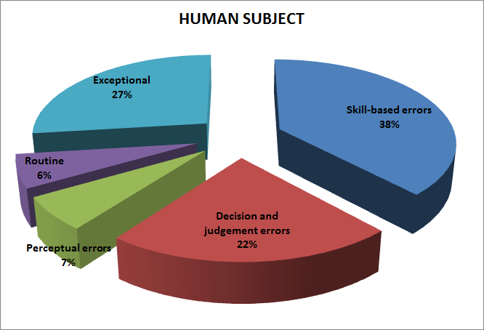
CONTRIBUTORY FACTOR ANALYSIS RESULTS
UNSAFE ACT

Slide 15
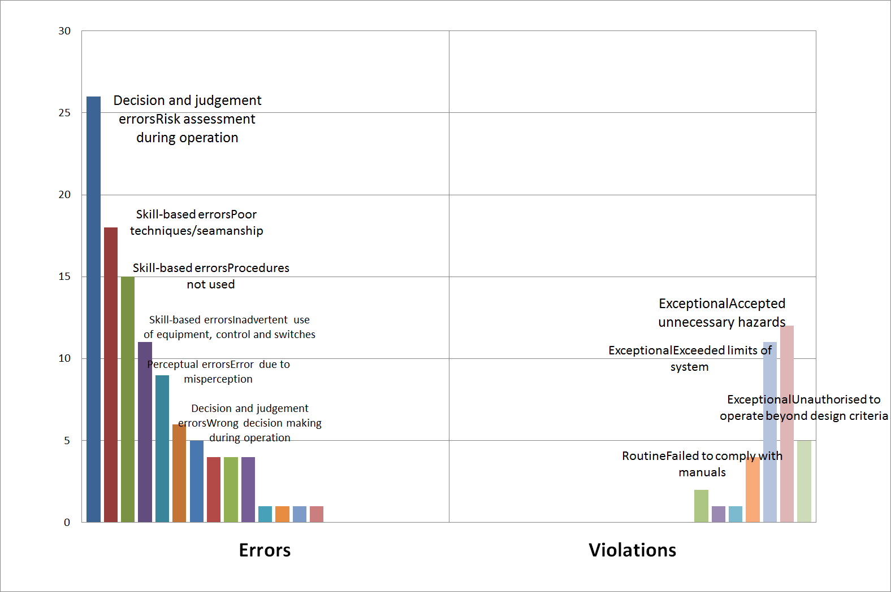
UNSAFE ACT – FIRE ONBOARD FERRY

Slide 16
SEMOMAP’s Stages of Accident (Phase-1-3)

Slide 17
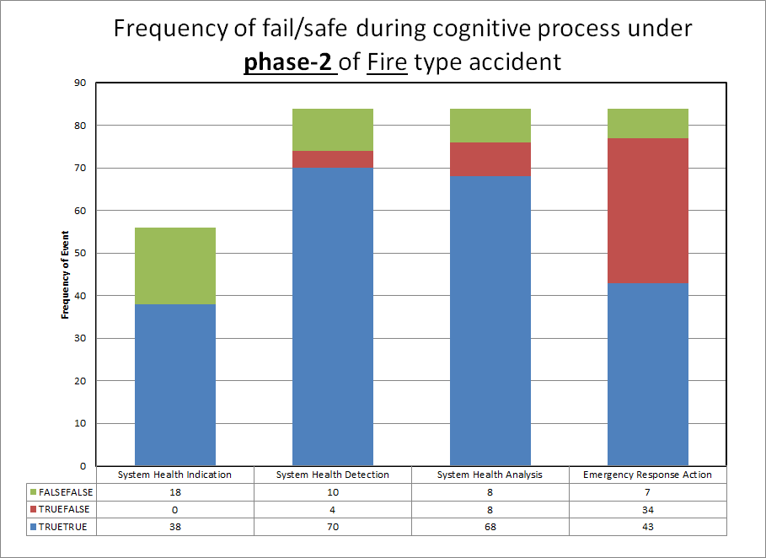
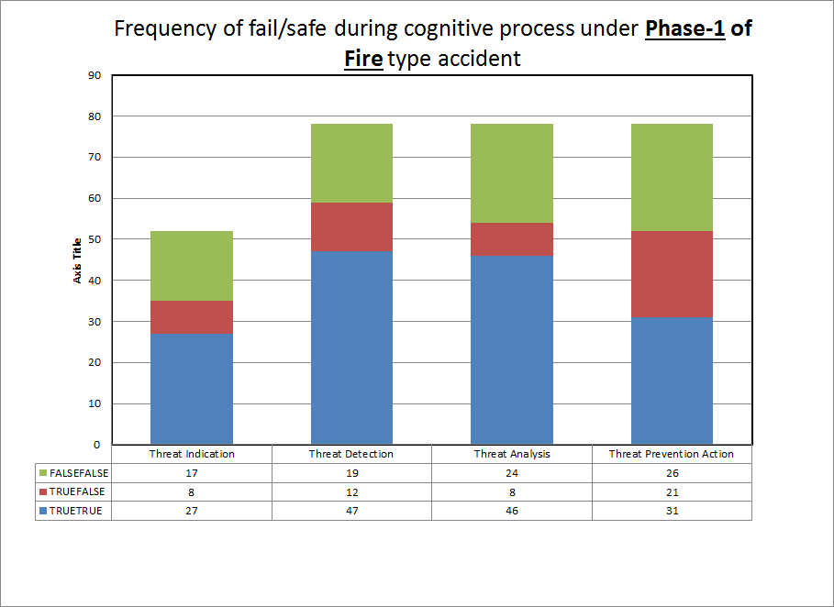
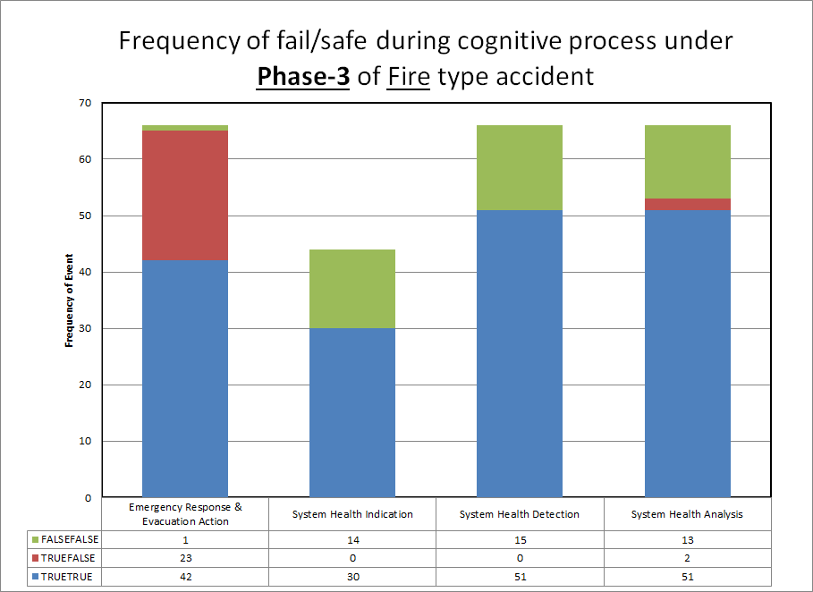
Pattern of Failure in RORO Ferry Fire Accident

Slide 18
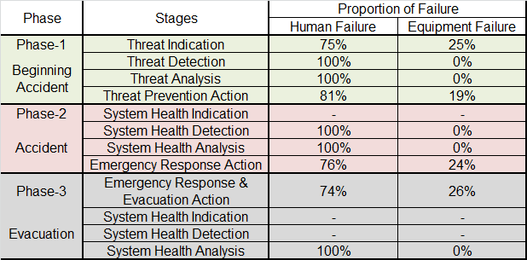
ACCIDENT DEVELOPMENT STAGES

Slide 19
General Issues in Fire onboard Ropax
Shortcoming of Equipment
Complacency
Crew Preparedness
  Training
  Familiarisation
Control of Passengers
Operational Issues
Unreported cargo inside Vehicles

Slide 20
Conclusion
Fire onboard Ferry Ropax has significant degree of difficulties;
Control of passengers;
Awareness and readiness of the crew;
Consistent supervision to the ferry operation.

Slide 21
Thank You
Jl. Medan Merdeka Timur No 5, Jakarta. 10110 INDONESIA
Telp. (+62) 21 384 7601; Fax (+62) 21 351 7606
Website :
http://www.dephub.go.id/knkt
E-mail :
knkt@dephub.go.id;
marine.knkt@dephub.go.id

